Slide 1

LPU-AICA LPU Artificial Intelligence Communication Assistant

Slide 2

Team Members
12107634 Sumanth 12106096 Easwanth 12108102 Vijay Vardhan

Slide 3
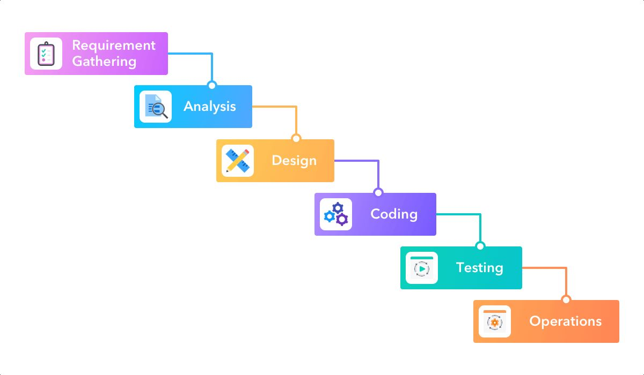
Iterative Waterfall model

Slide 4
Requirements
Visual Studio My SQL
Dialog Flow
org.apache.sling.commons.log-2.1.2
Slf4j-api-2.0.99
Webcame-capture-0.3.12
Figma
SQL
JFrames

Slide 5

Analysis of resources
After finding the requirements we decided to start with Setting up the environment for coding and design
we have chosen visual studio for coding and Figma for designing
Then we decided to make a plan to manage time so we built a Gantt chart

Slide 6
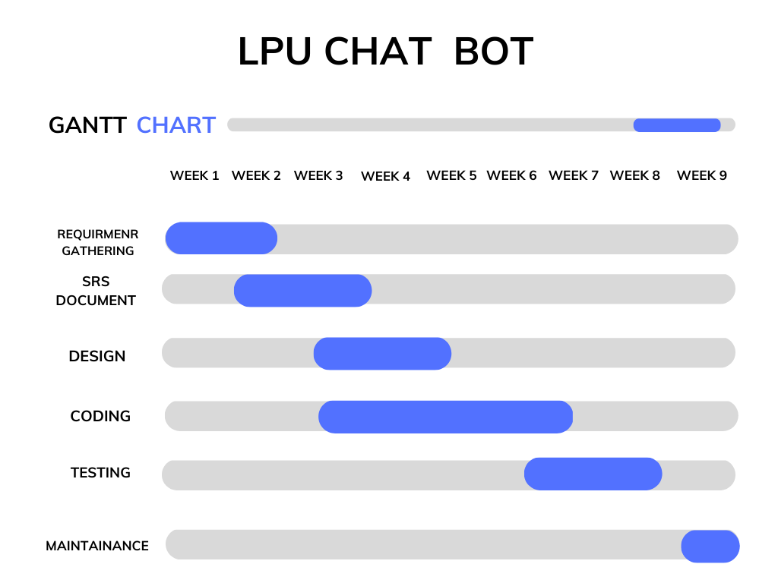
Gantt Chart

Slide 7
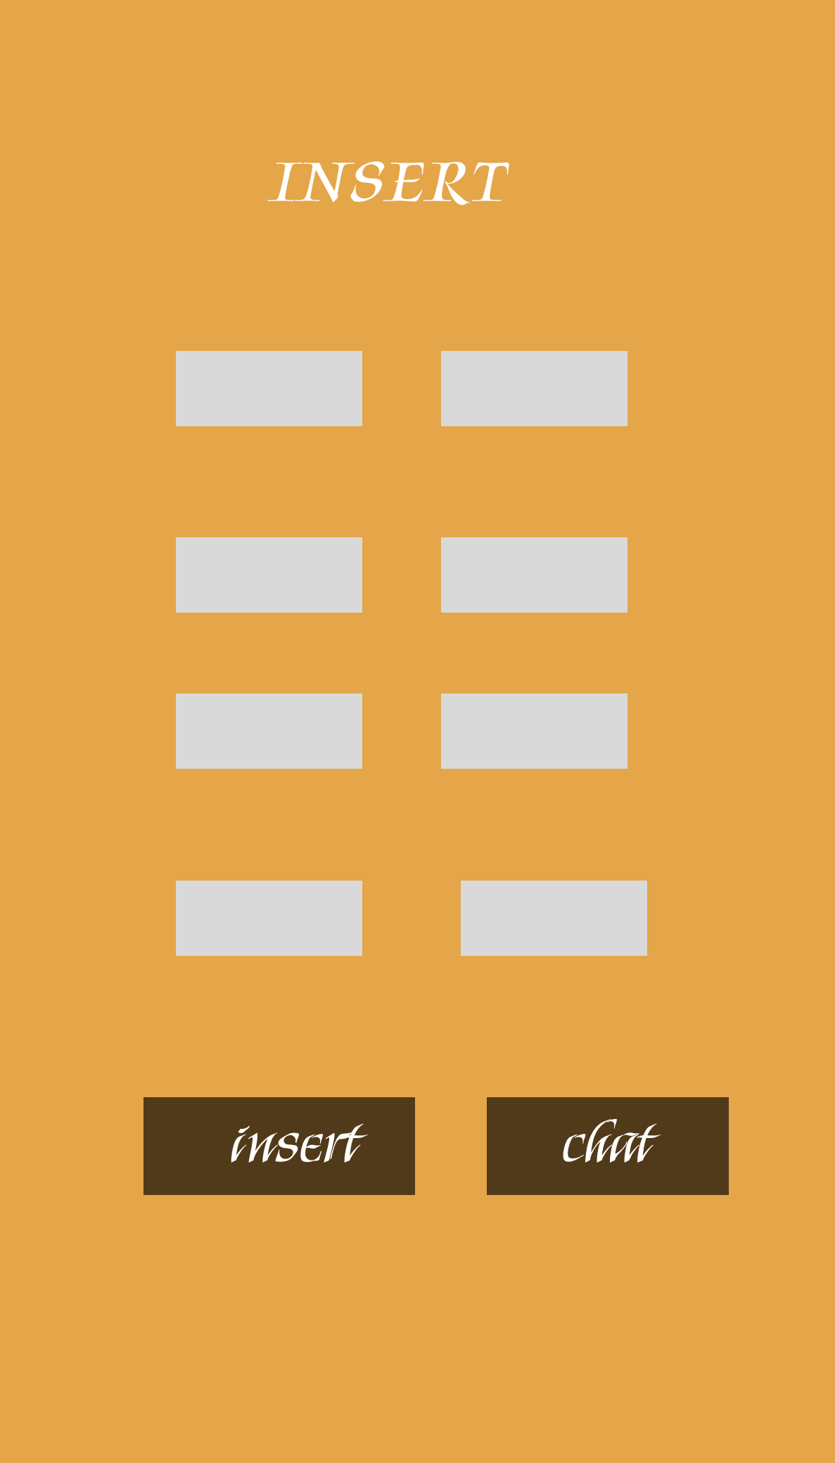

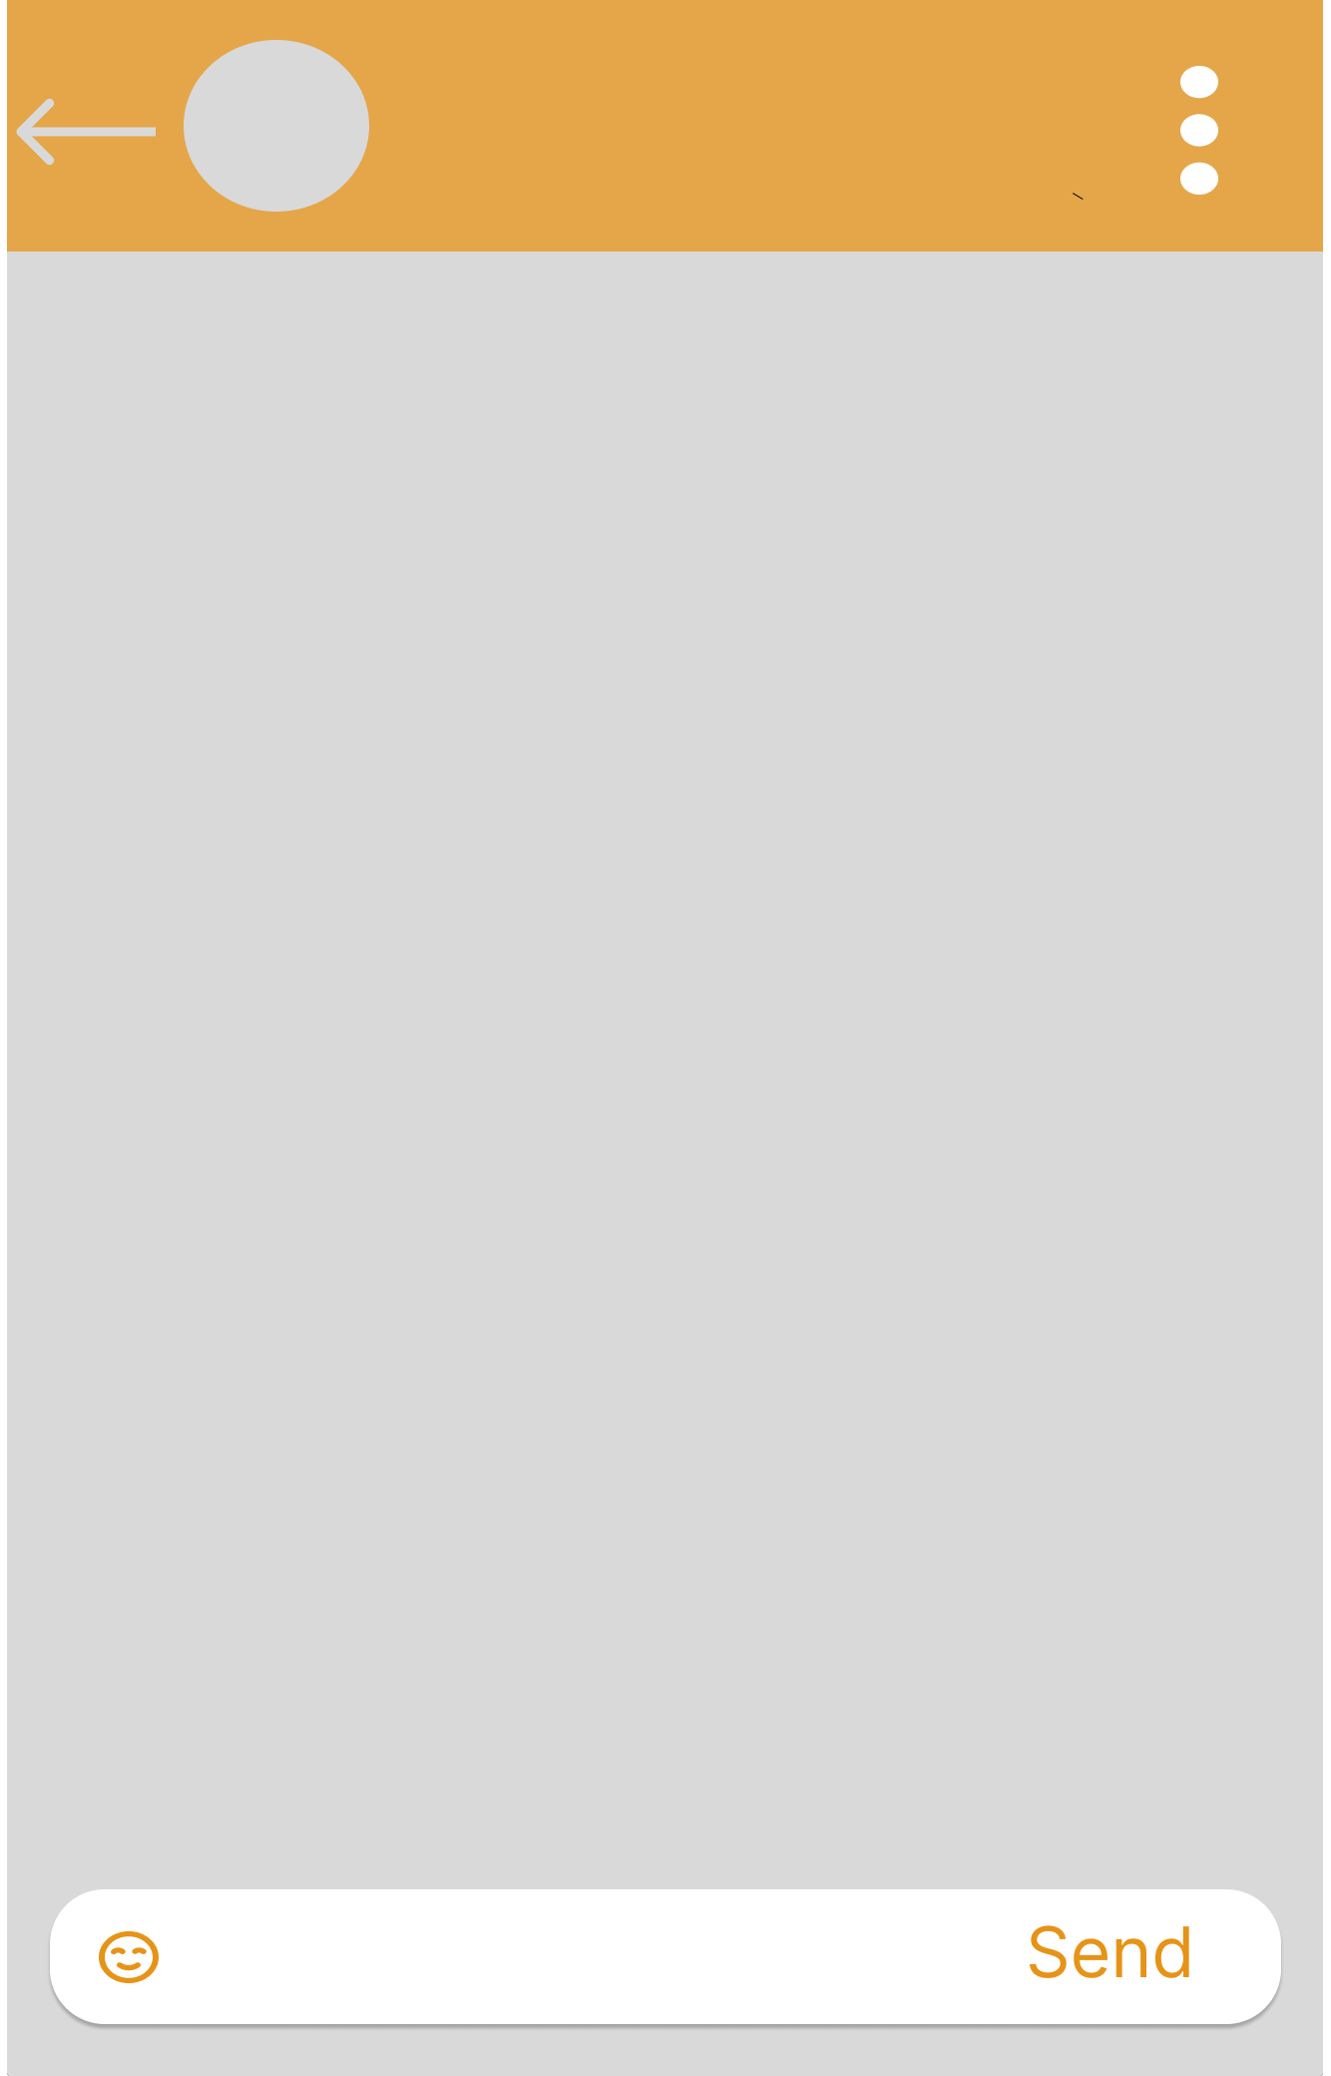
DESIGN
These are designs that we implemented on Figma

Slide 8

Coding
The frames were created using java frames and Java swing
To open the default camera we implemented Slf4j-api-2.0.99
Constructors were used mostly to make work easy
Mysql is used for connecting to databases and to get data values
Java awt is used for some color identification

Slide 9
Testing
Start Button
Text field and Send
Menu bar
Working on camera
Inserting values into the database
Deleting values from the database
Minimization of the gap between labels
Alignment of labels on left and right

Slide 10

Maintenance
No matter how good the product is with out improvisions
So to make our model more improved we generated a google form
We almost taken around 100 responses
Google form link🔗
https://forms.gle/8qWdZ2kmEeVSLHjz6

Slide 11

Dialogflow
Dialogflow is a conversational AI platform developed by Google
Dialogflow is an NLP (Natural Language Processing) platform
Dialogflow's NLU service enables chatbots and voice assistants to understand and interpret natural language input from users.

Slide 12

Thank You

